Slide 1
Java Class
Day 8

Slide 2





Jul
Aug
Big Data Analyst(10/1)
ADsP(8.28) 8/1~8/5
8/29~9/2
TOEIC(7/24) 6/6~7/11
TOEIC(8/07) 6/20~7/25
TEPS(7/16) 6/29~7/12
TEPS (8/06) 6/20~7/17
TOEIC(8/21) 7/ 4 ~ 8/ 8
TEPS (8/20) 7/ 4 ~7/31
www.toeic.co.kr
www.teps.or.kr
www.dataq.or.kr
austin.sogang.ac.kr
austiny.snu.ac.kr

Slide 3
Mon
Tue
Wed
Thu
1. Main
2. Main
3. Main
4. Main
LUNCH
5. Sub
6. Sub
7. Sub
8. Recap, Test
Fri
1. Recap Sub
2.
3.
4.
LUNCH
5. Recap Main
6.
7.
8. Test
Jul
Java Basic
Aug
Java Intermediate
Database
HTML, CSS, JS

Slide 4
Java
10 Inheritance & Super
10.1 Inheritance
10.1.1 Basic
10.1.2 Advance
10.2 Super
10.2.1 Basic
10.2.2 Advance
10.3 Exam
11 Modifier & Polymorphism
11.1 Modifier
11.1.1 Basic
11.1.2 Advance
11.2 Polymorphism
11.2.1 Basic
11.2.2 Advance
11.3 Exam

Slide 5
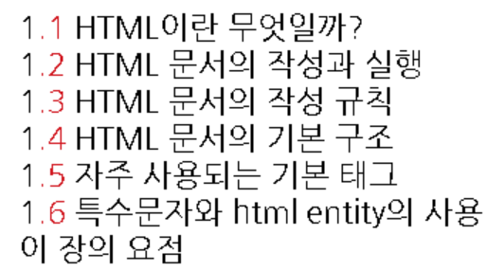
HTML

Slide 6
10 Inheritance & Super 10.1 Inheritance

Slide 7
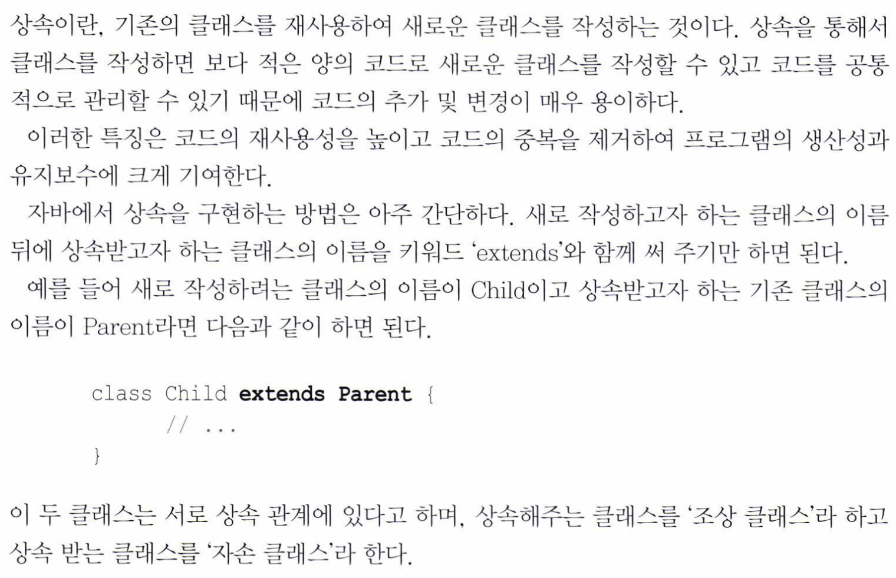

Slide 8
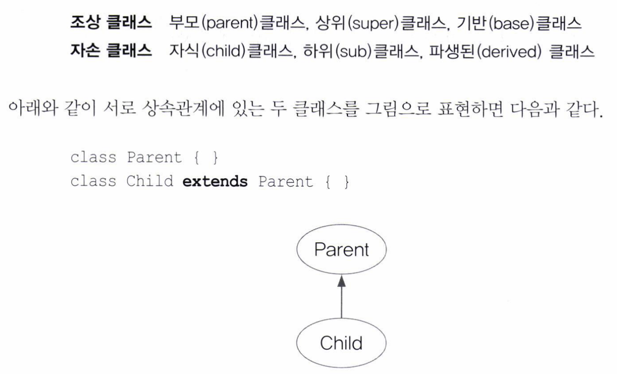

Slide 9
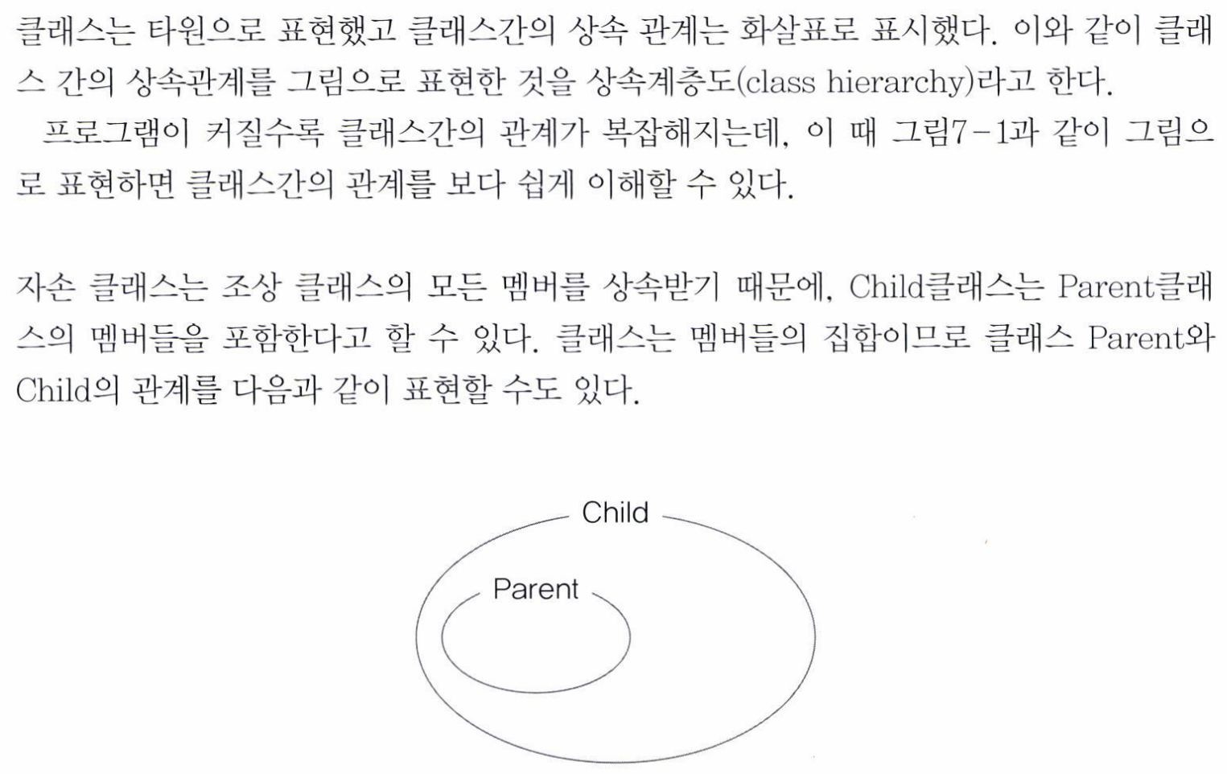

Slide 10
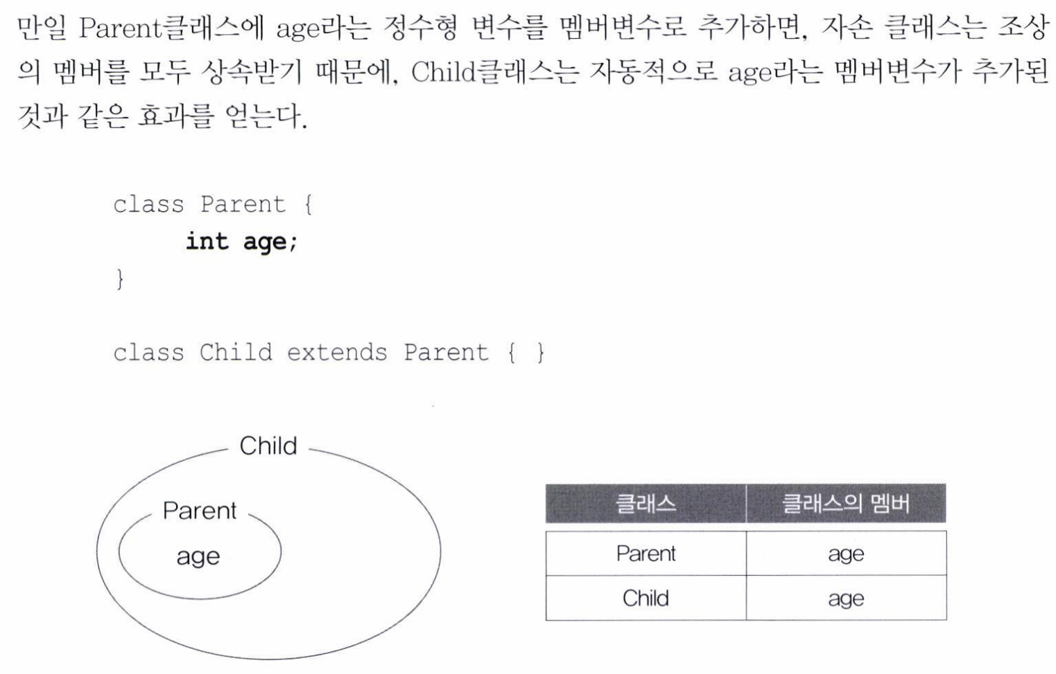

Slide 11
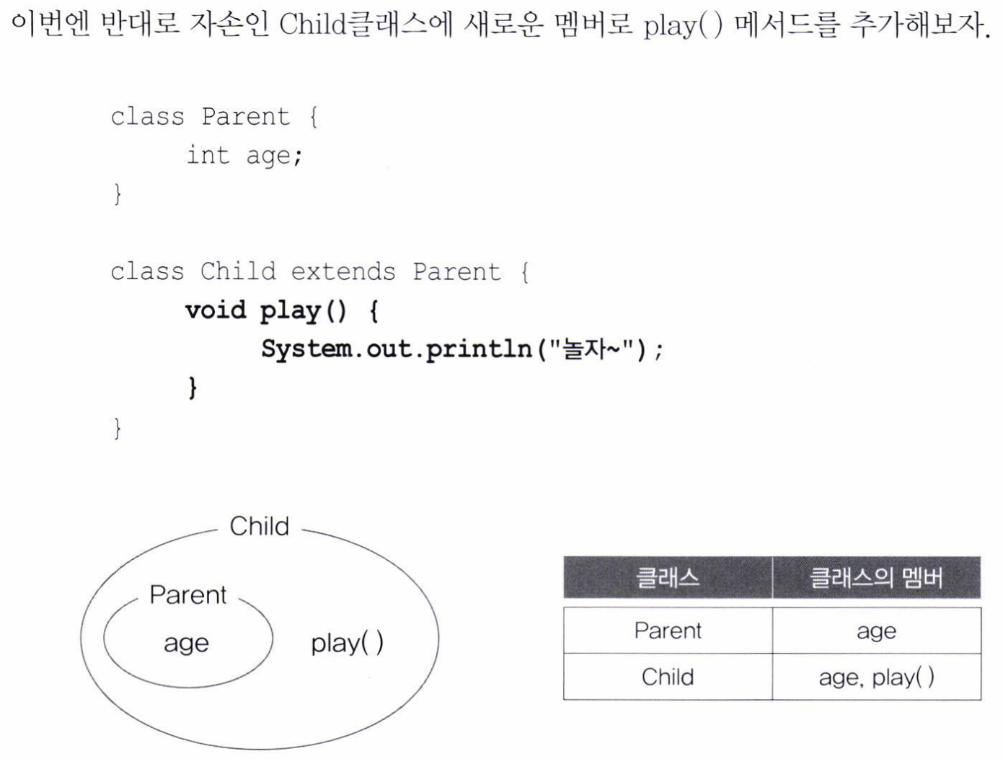

Slide 12
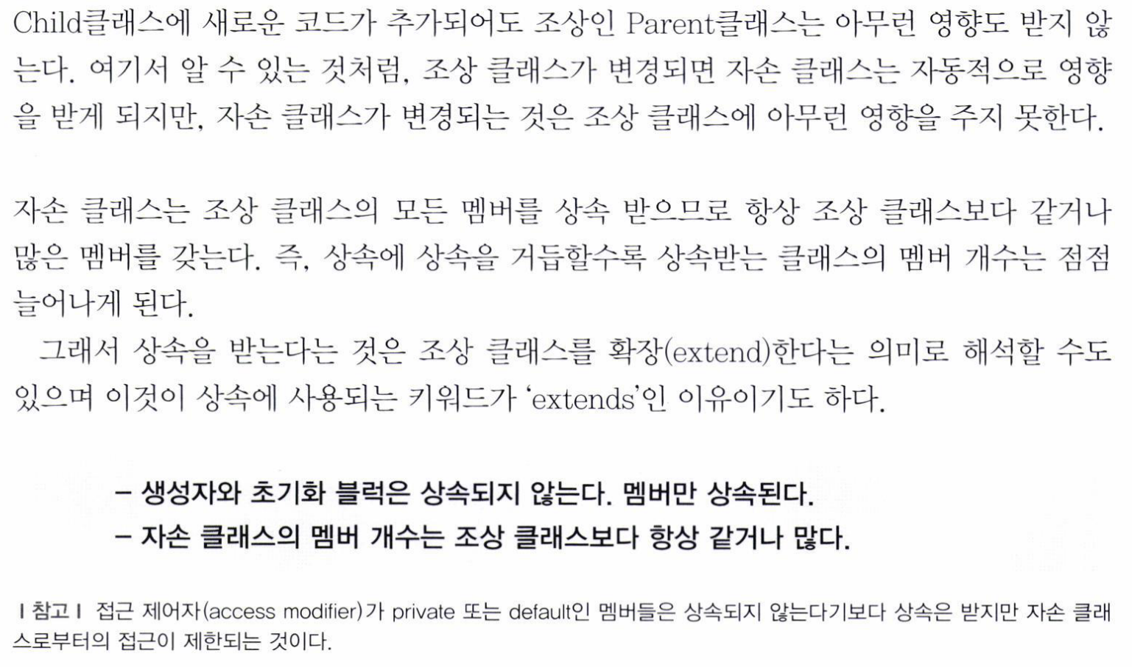

Slide 13
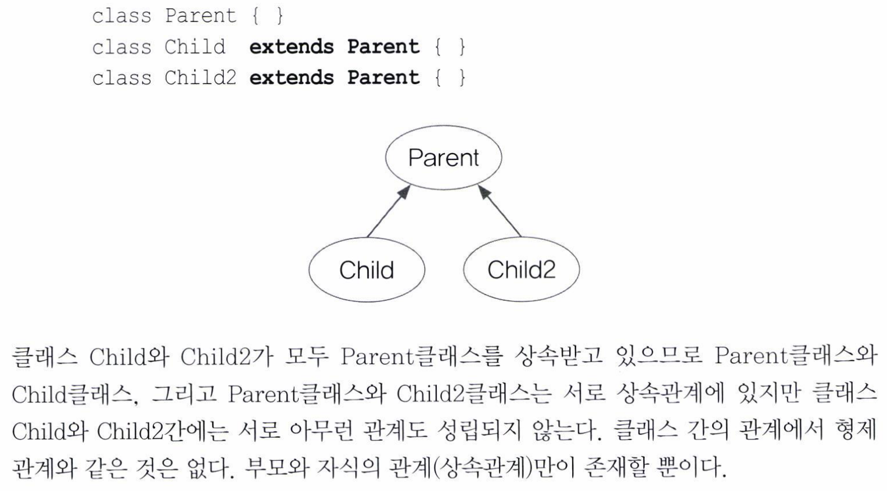

Slide 14
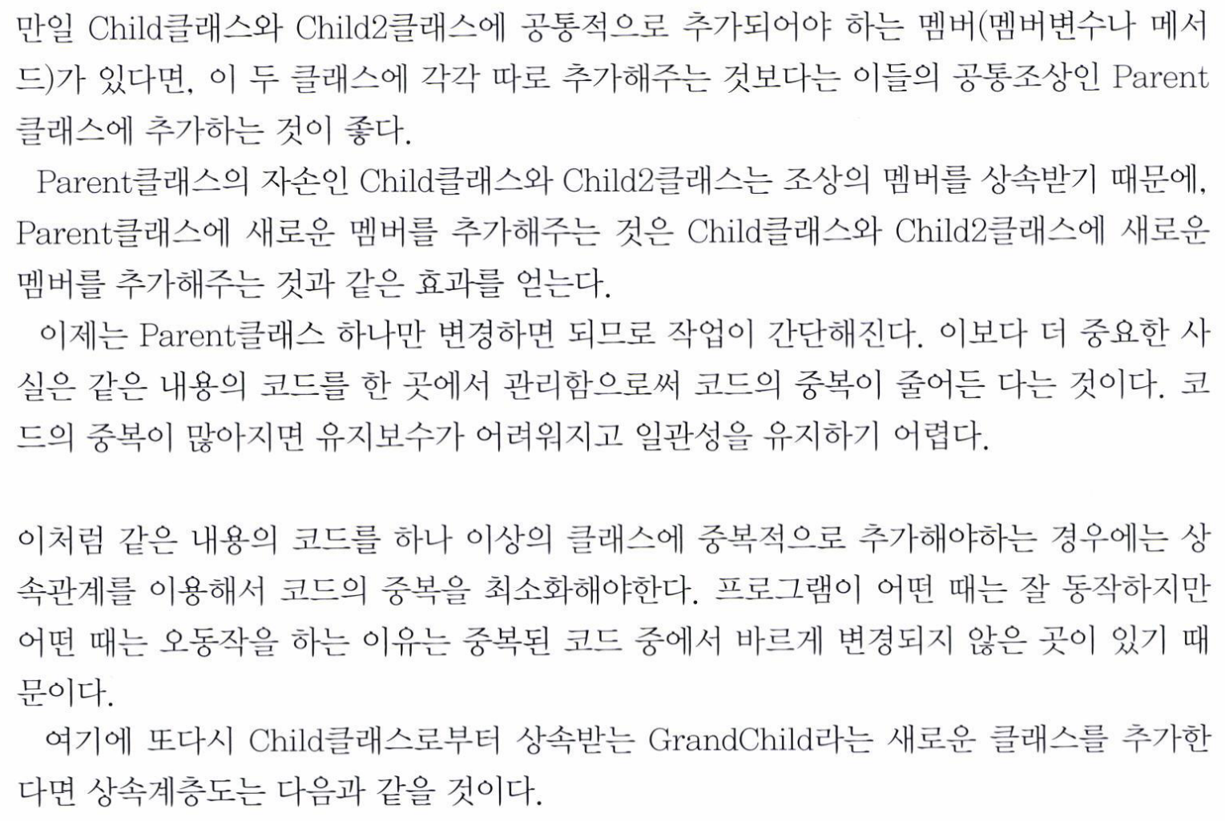

Slide 15
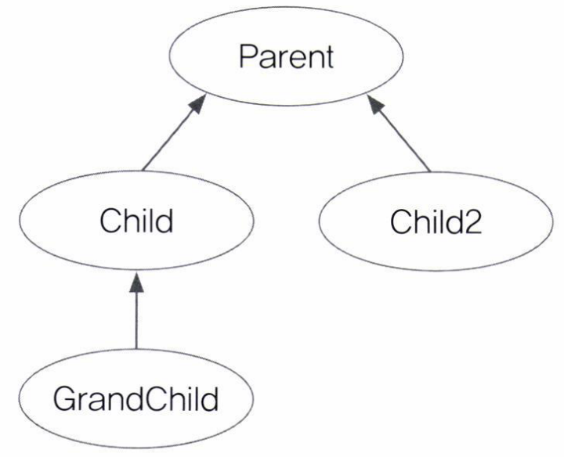
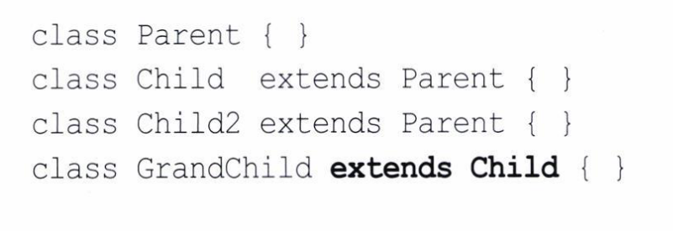

Slide 16
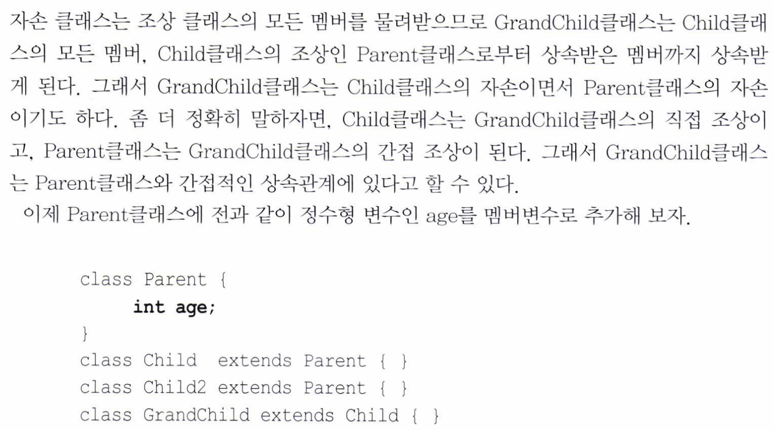

Slide 17
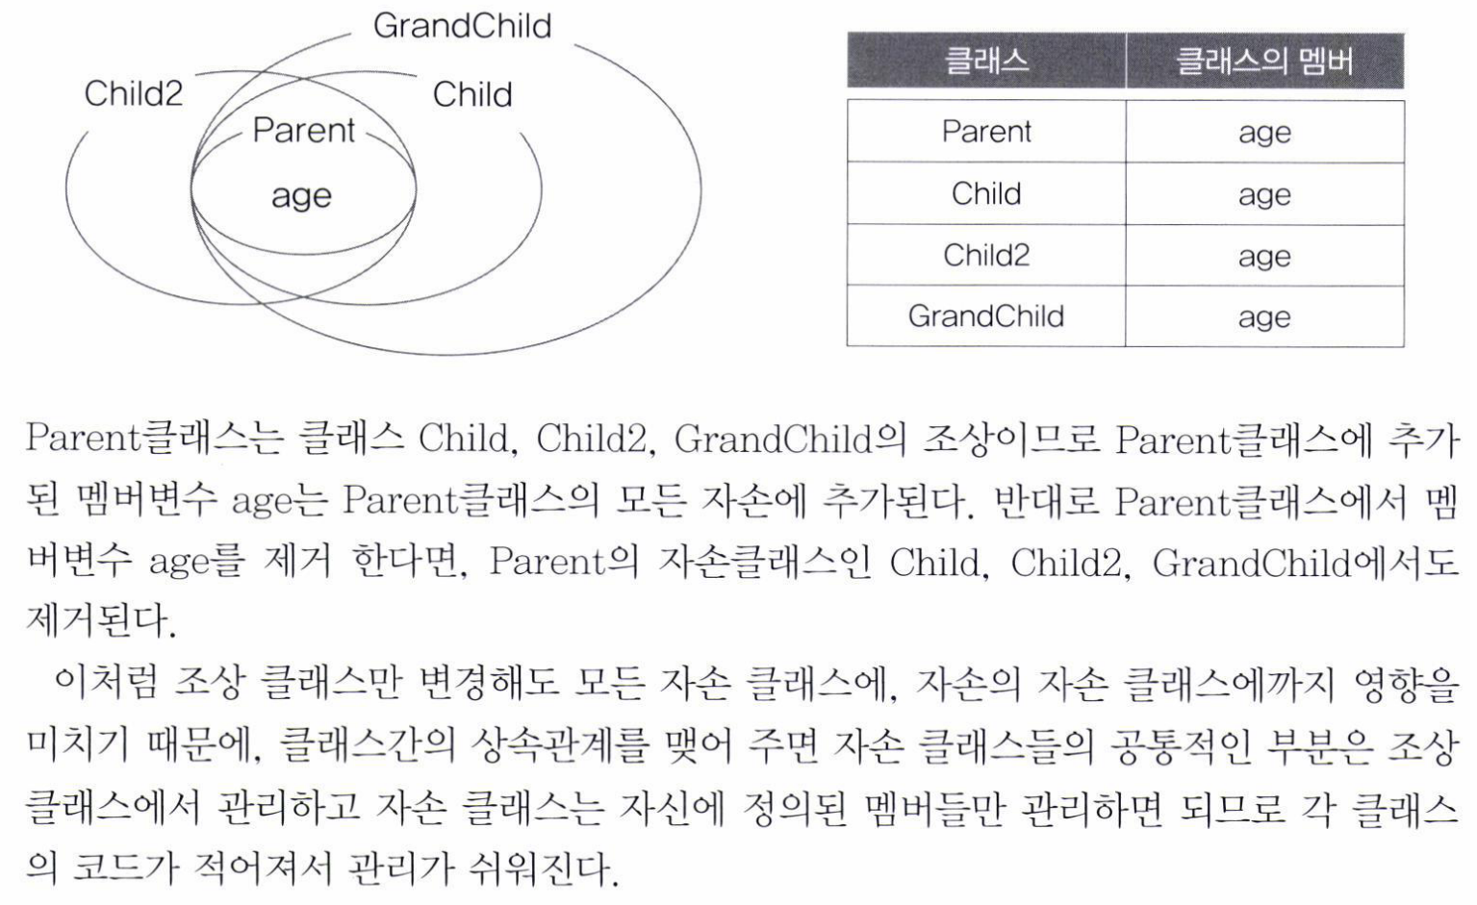

Slide 18
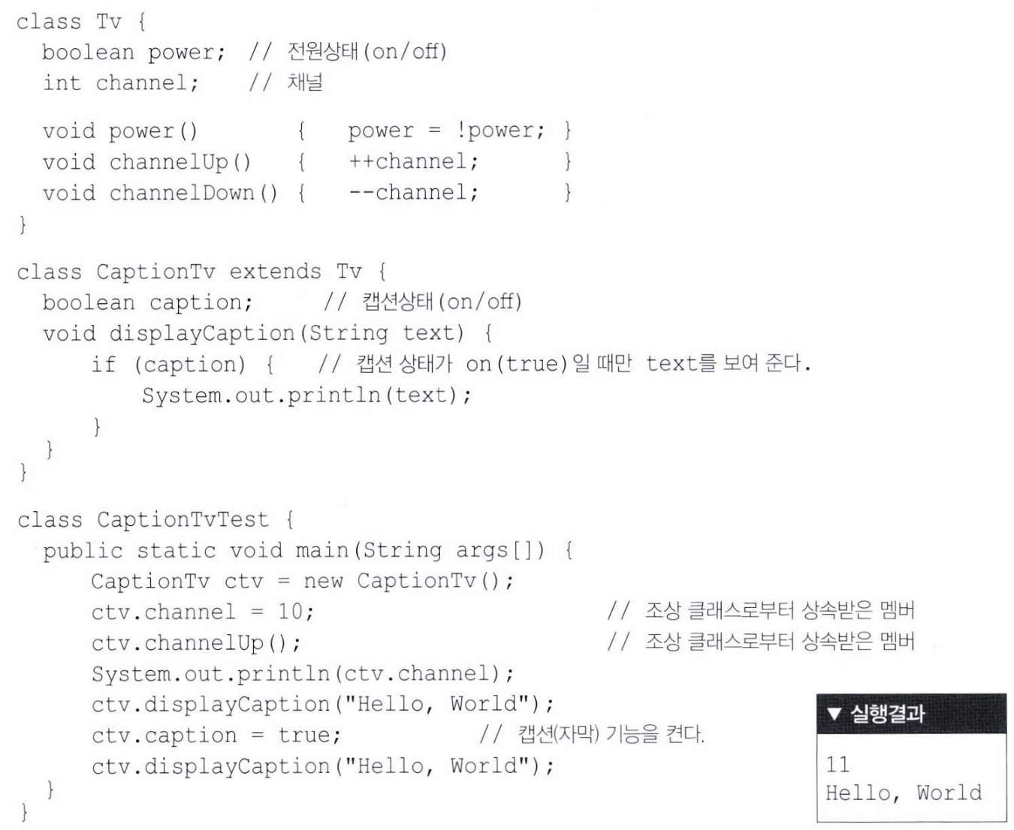

Slide 19
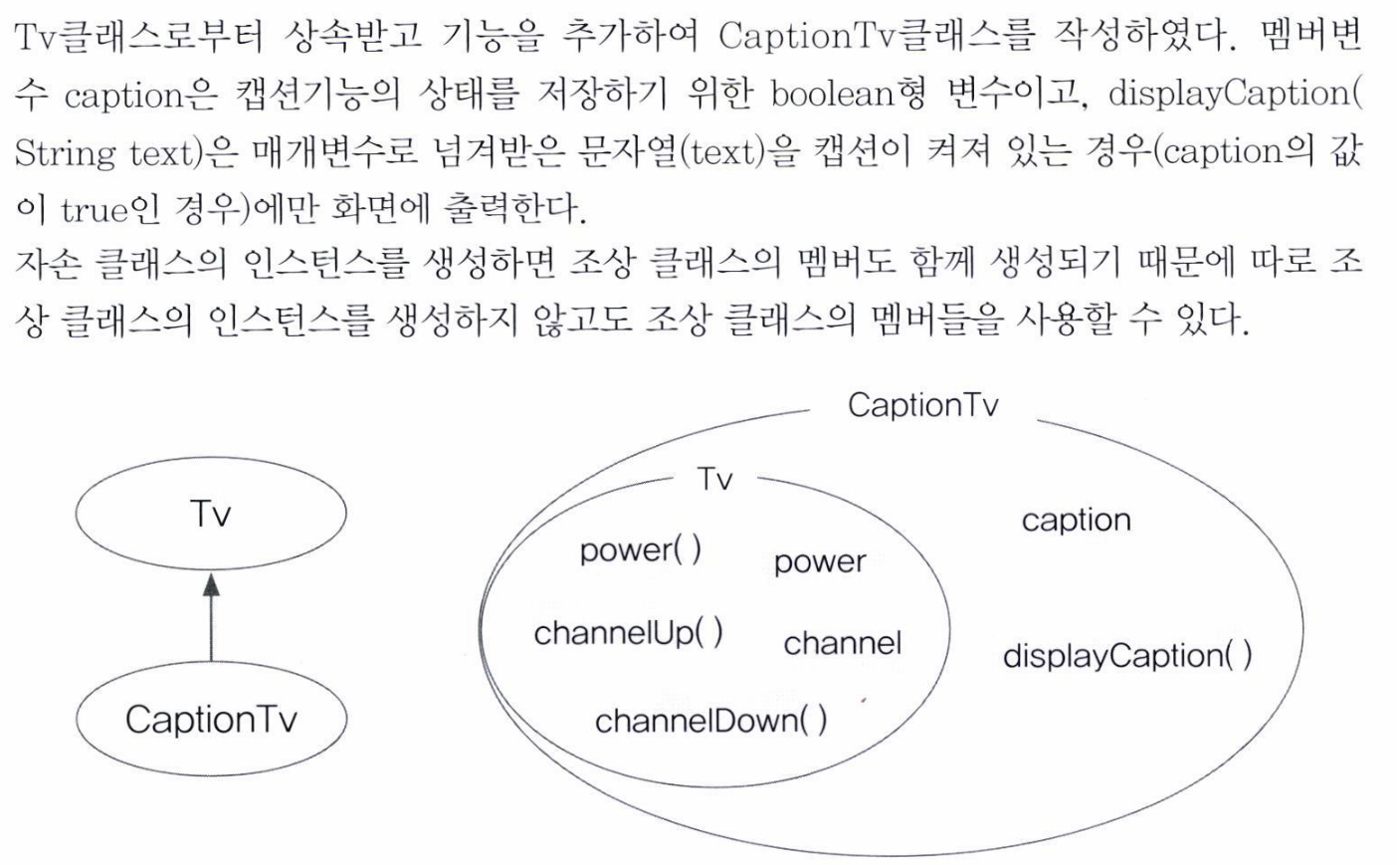

Slide 20
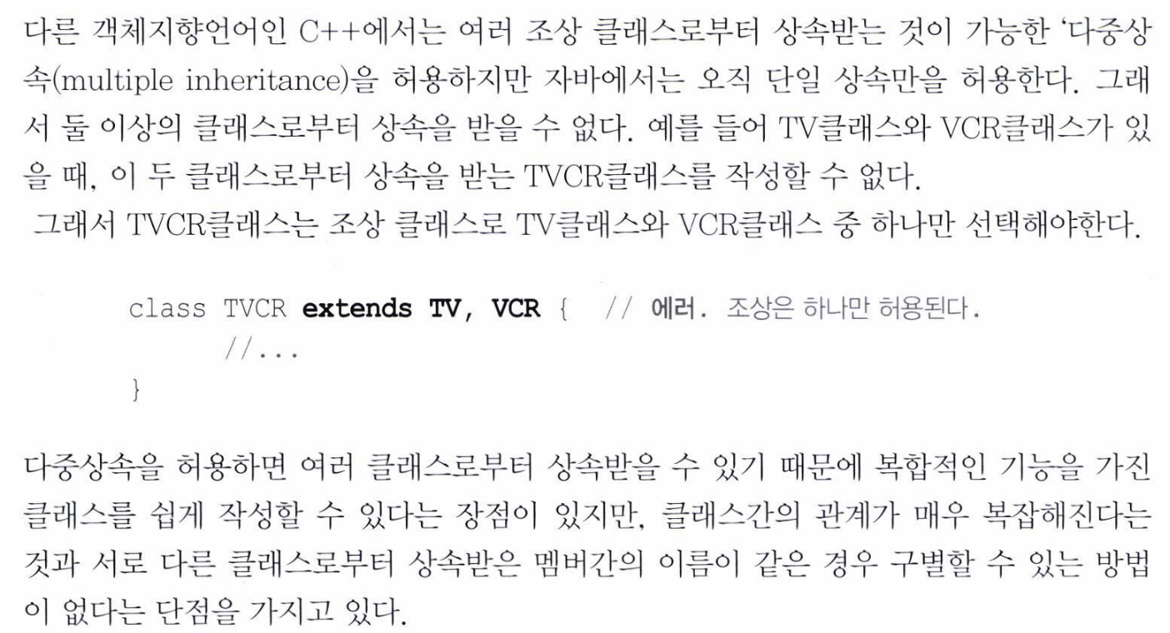

Slide 21
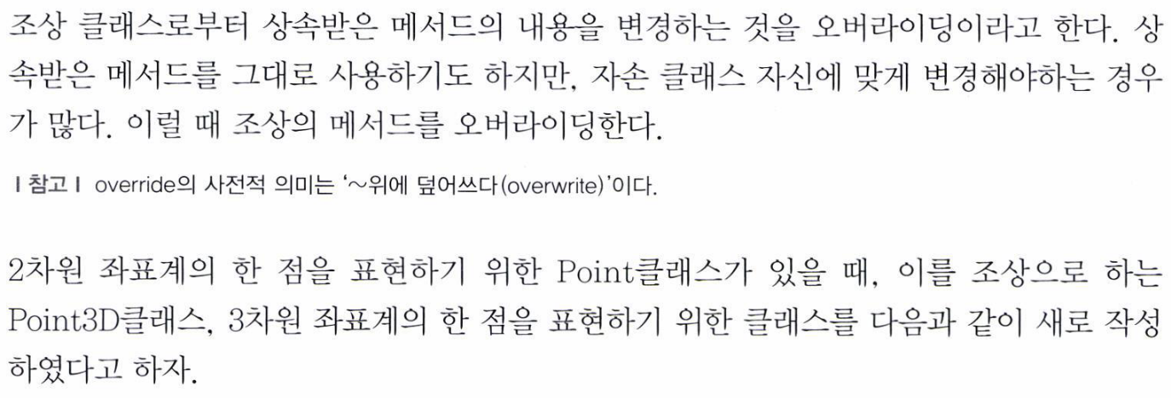
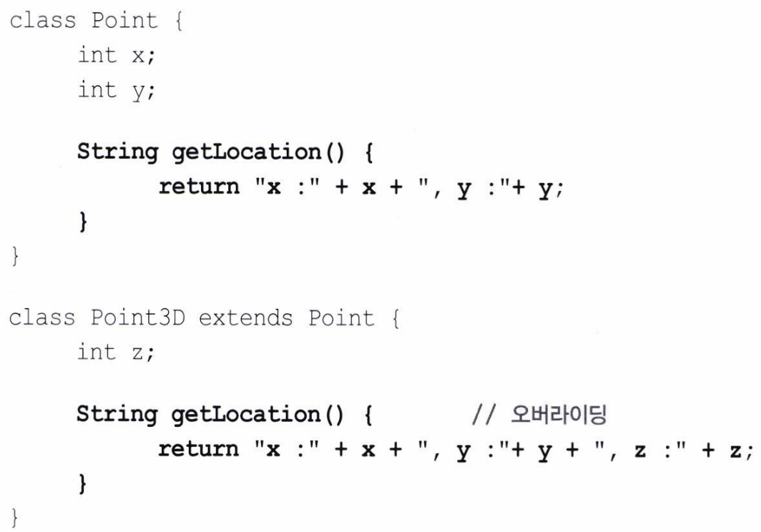

Slide 22
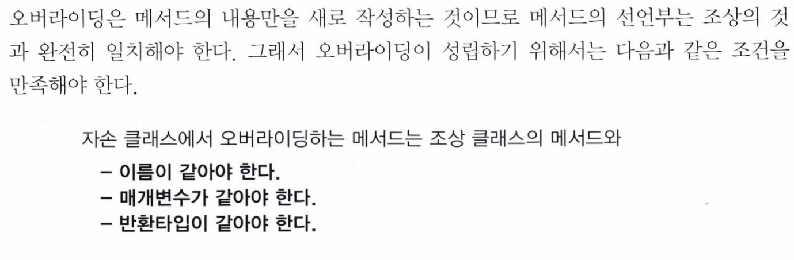
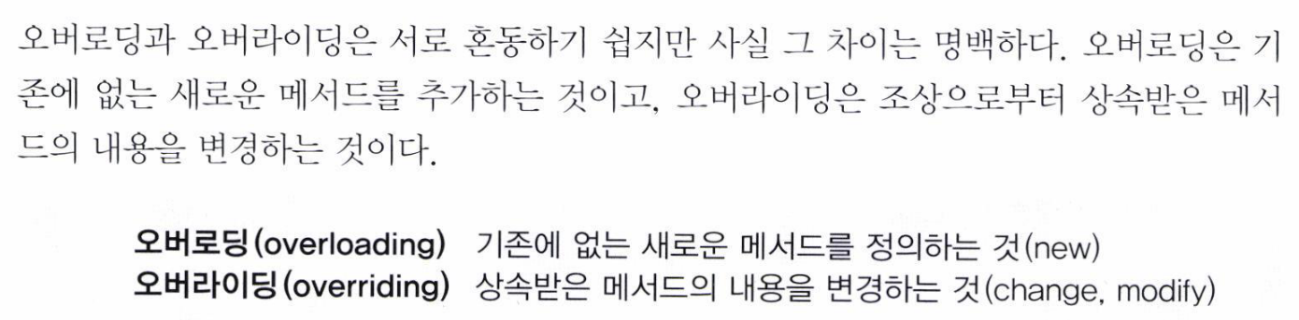

Slide 23
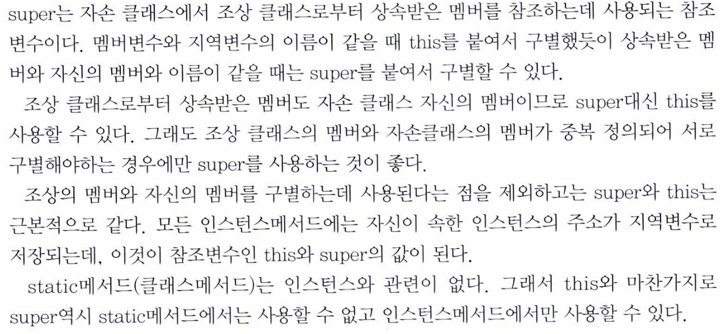

Slide 24
10 Inheritance & Super 10.2 Super

Slide 25
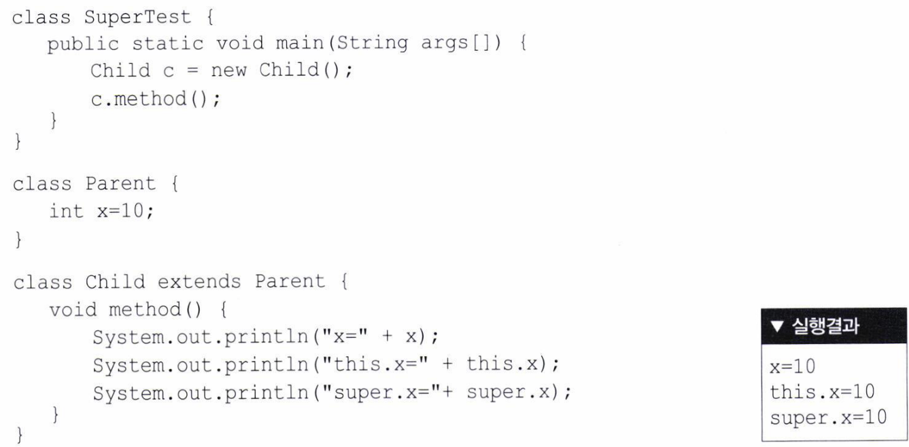

Slide 26
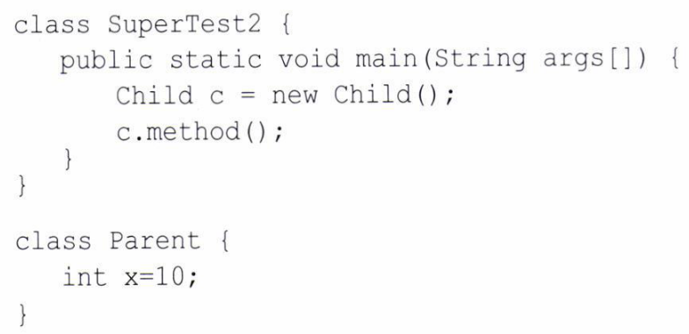
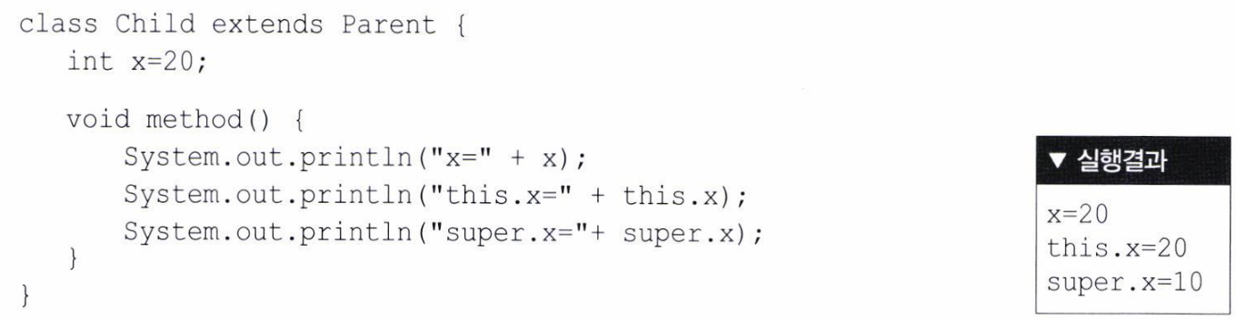

Slide 27
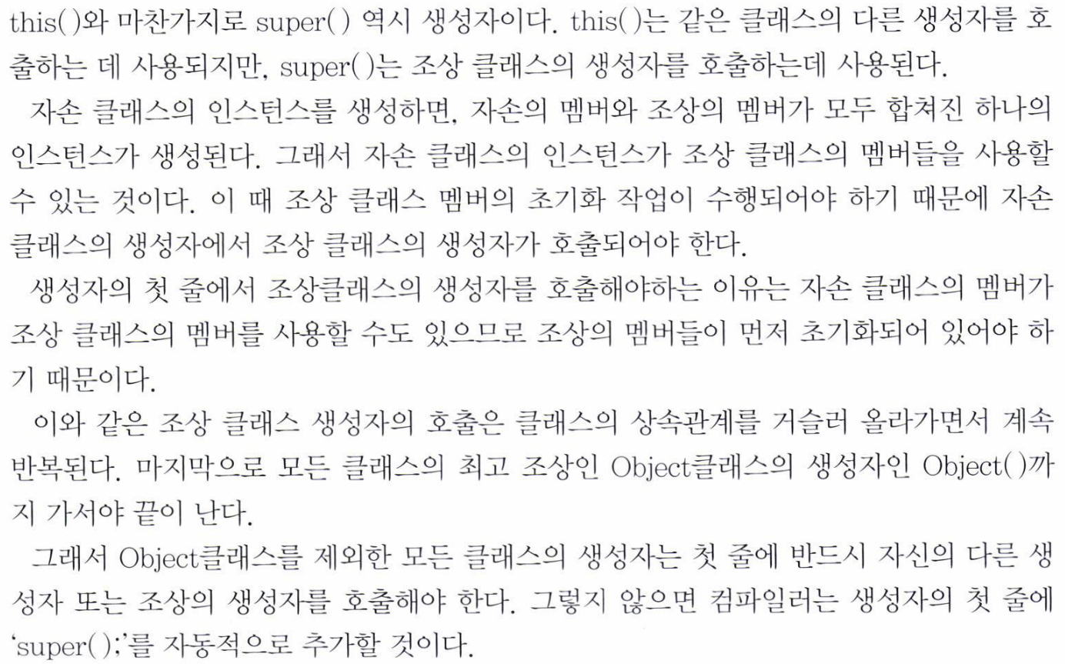

Slide 28
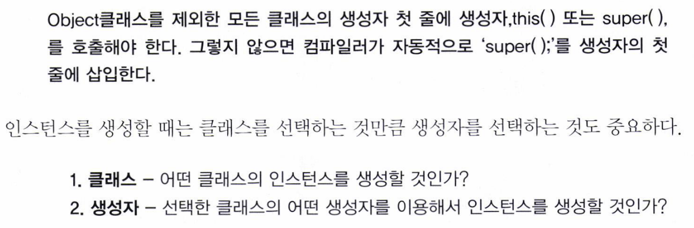

Slide 29
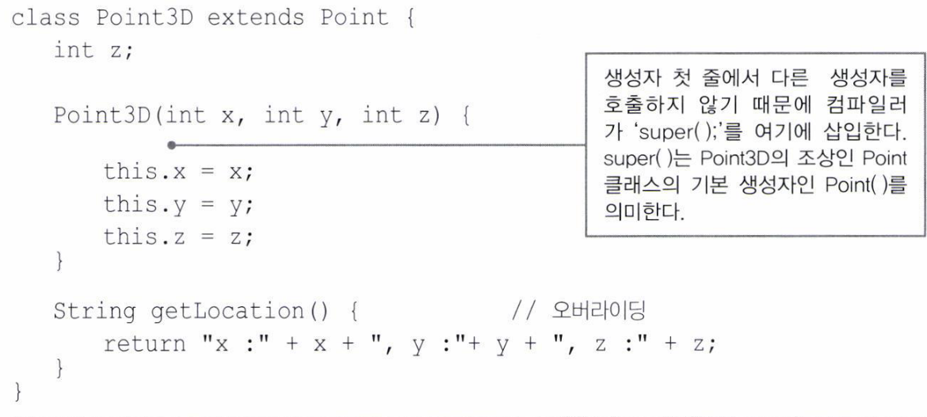
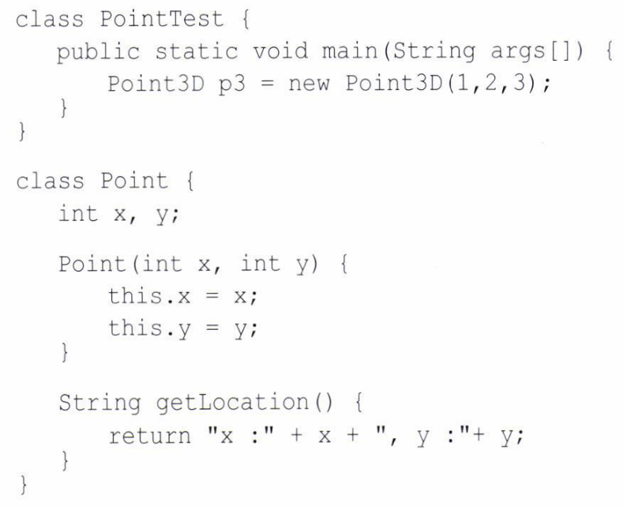
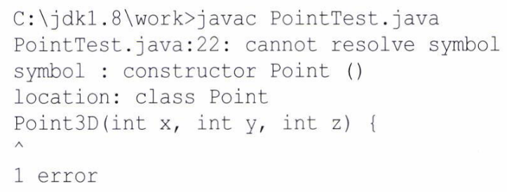

Slide 30
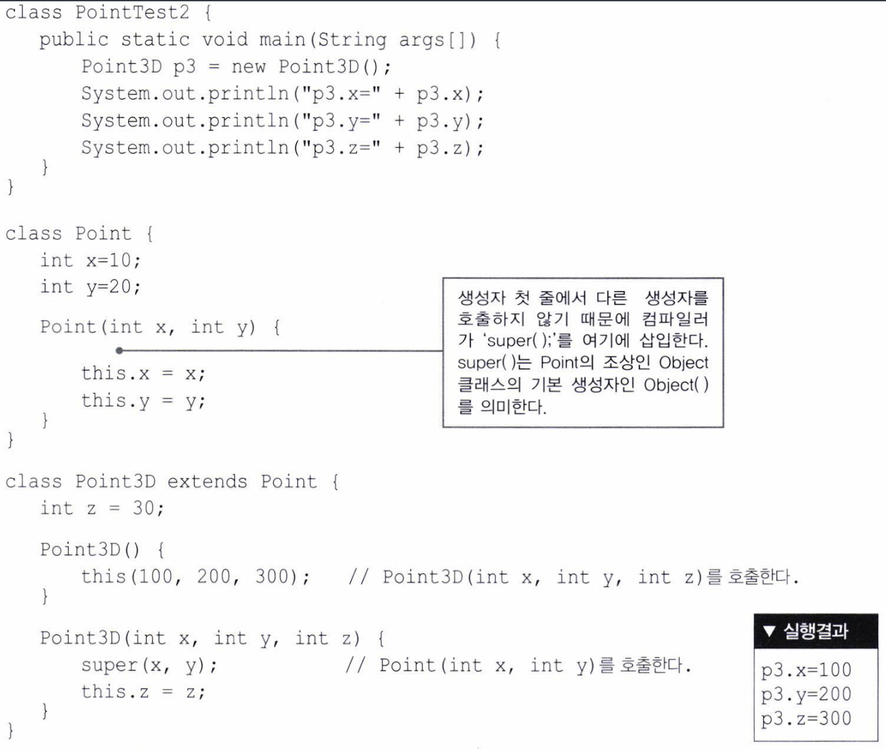

Slide 31
10 Inheritance & Super 10.3 Exam

Slide 32
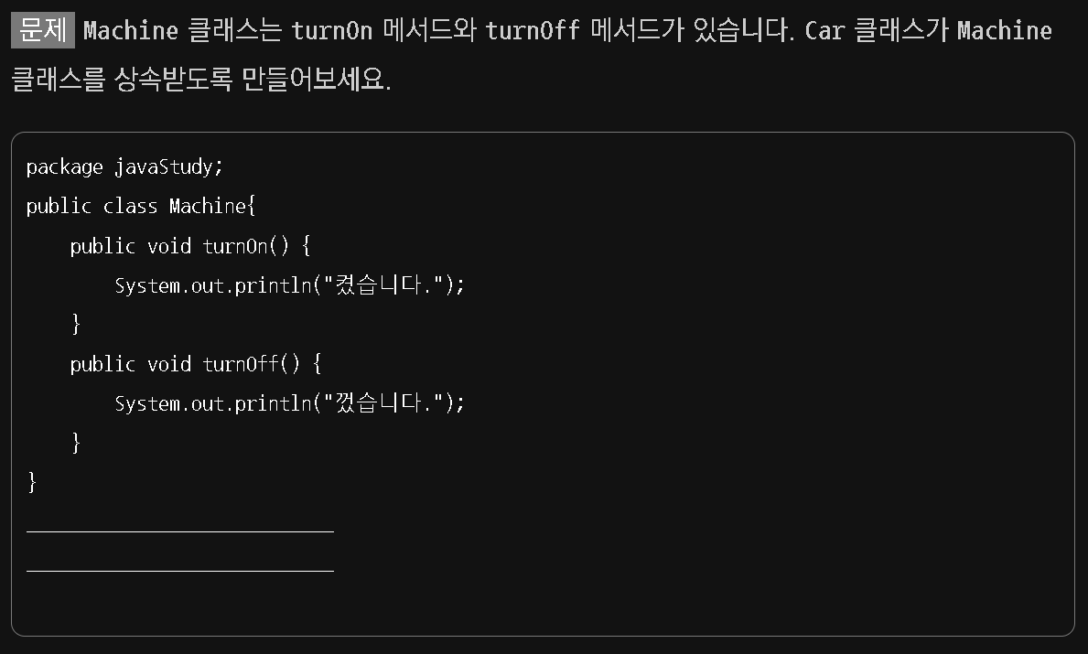
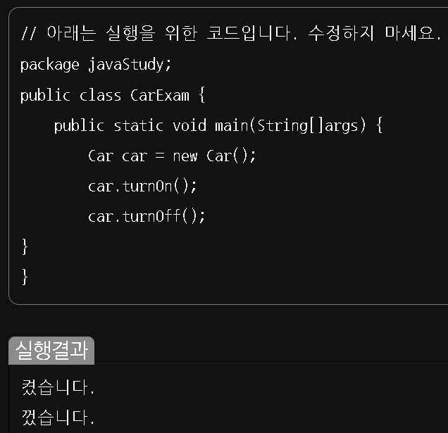

Slide 33
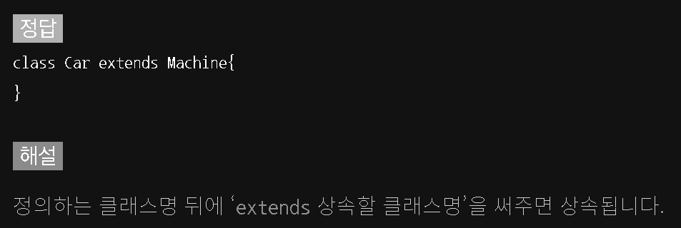

Slide 34
11 Modifier & Polymorphism 11.1 Modifier

Slide 35
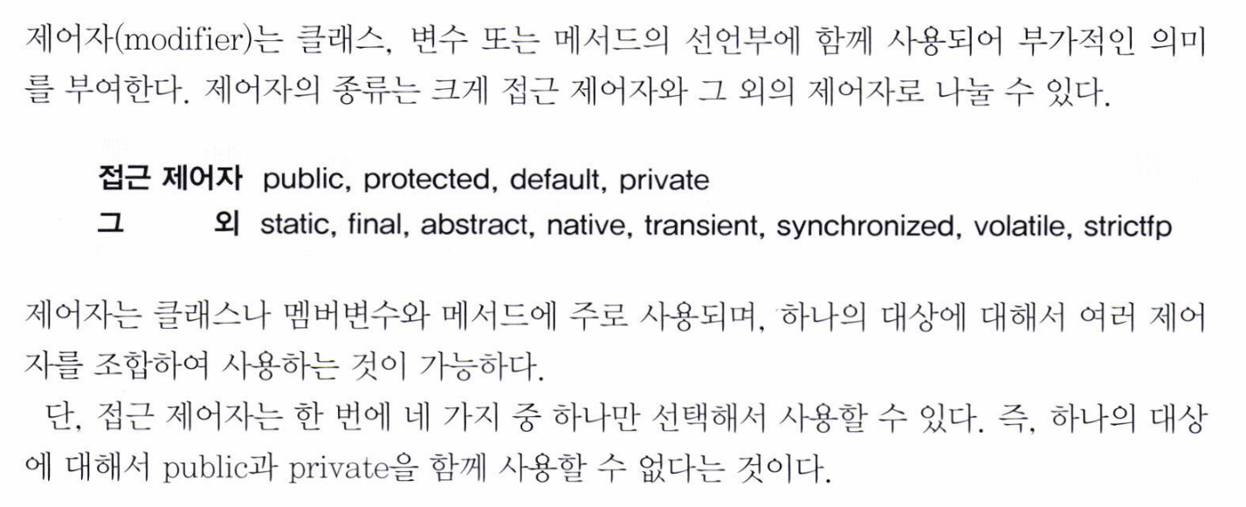

Slide 36
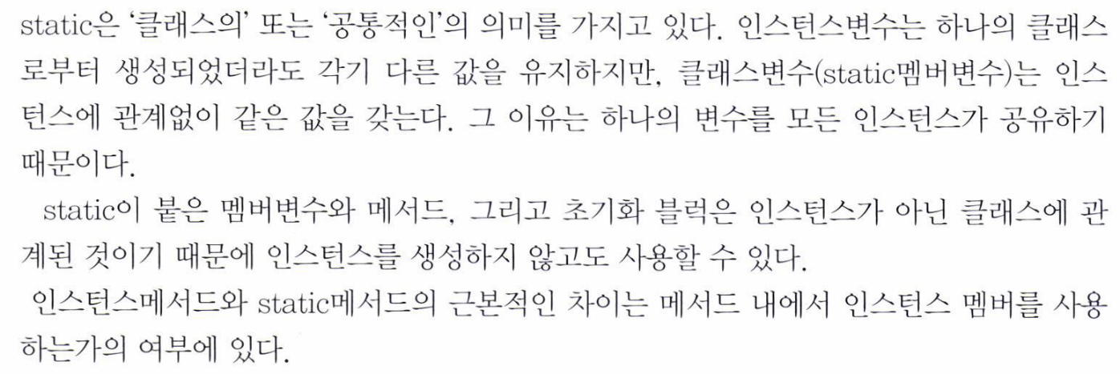

Slide 37
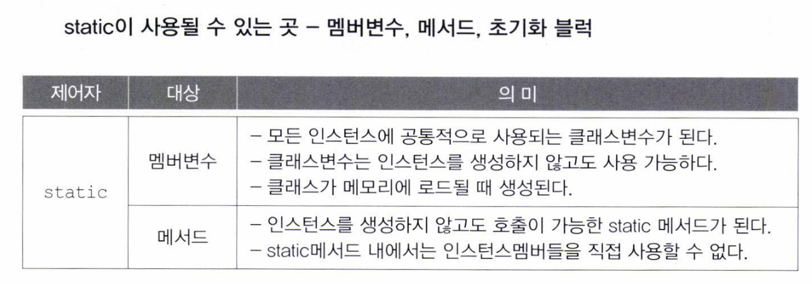

Slide 38
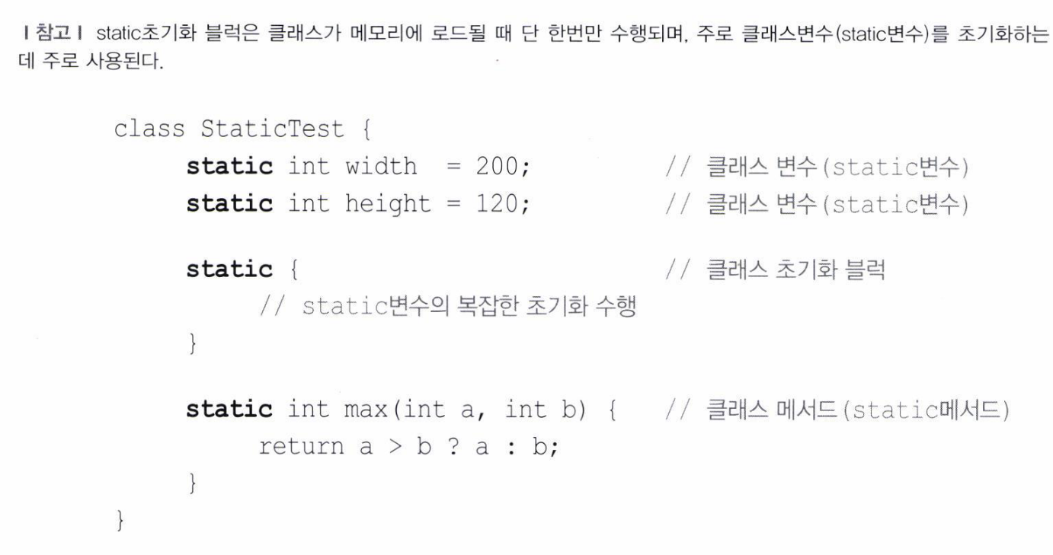

Slide 39
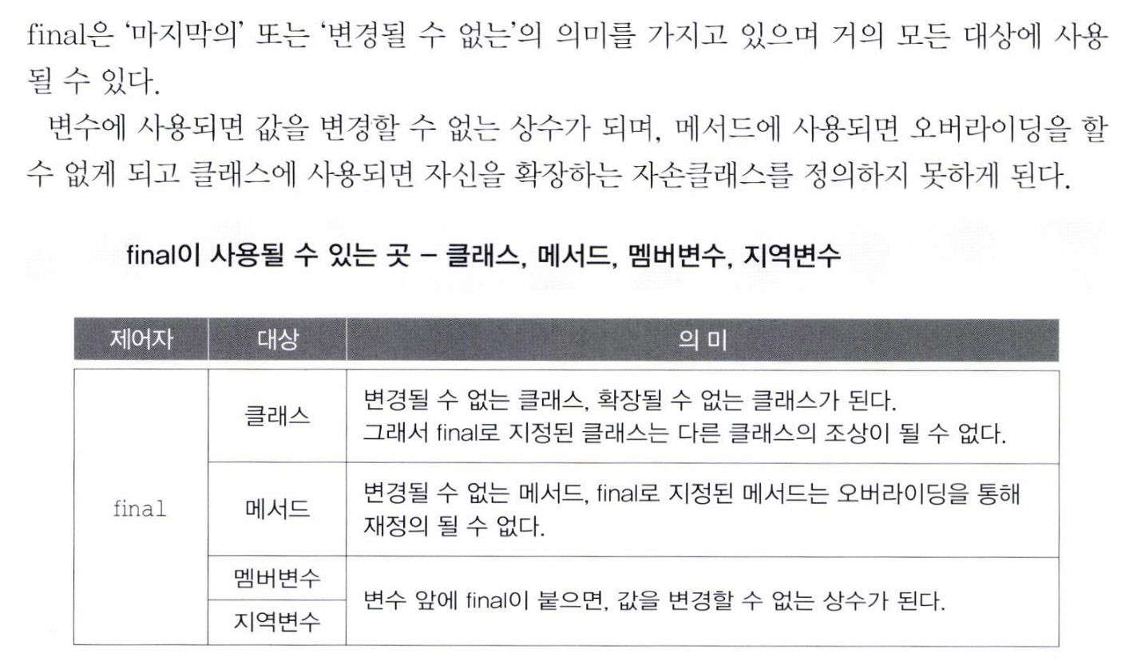

Slide 40
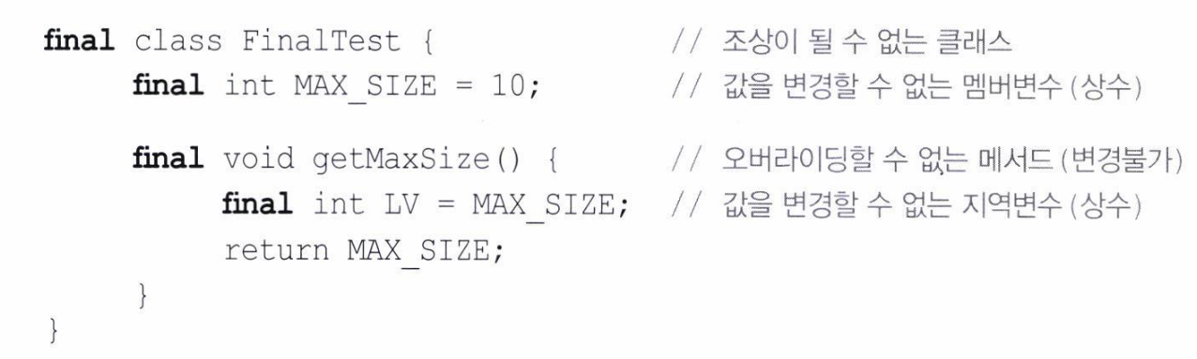

Slide 41
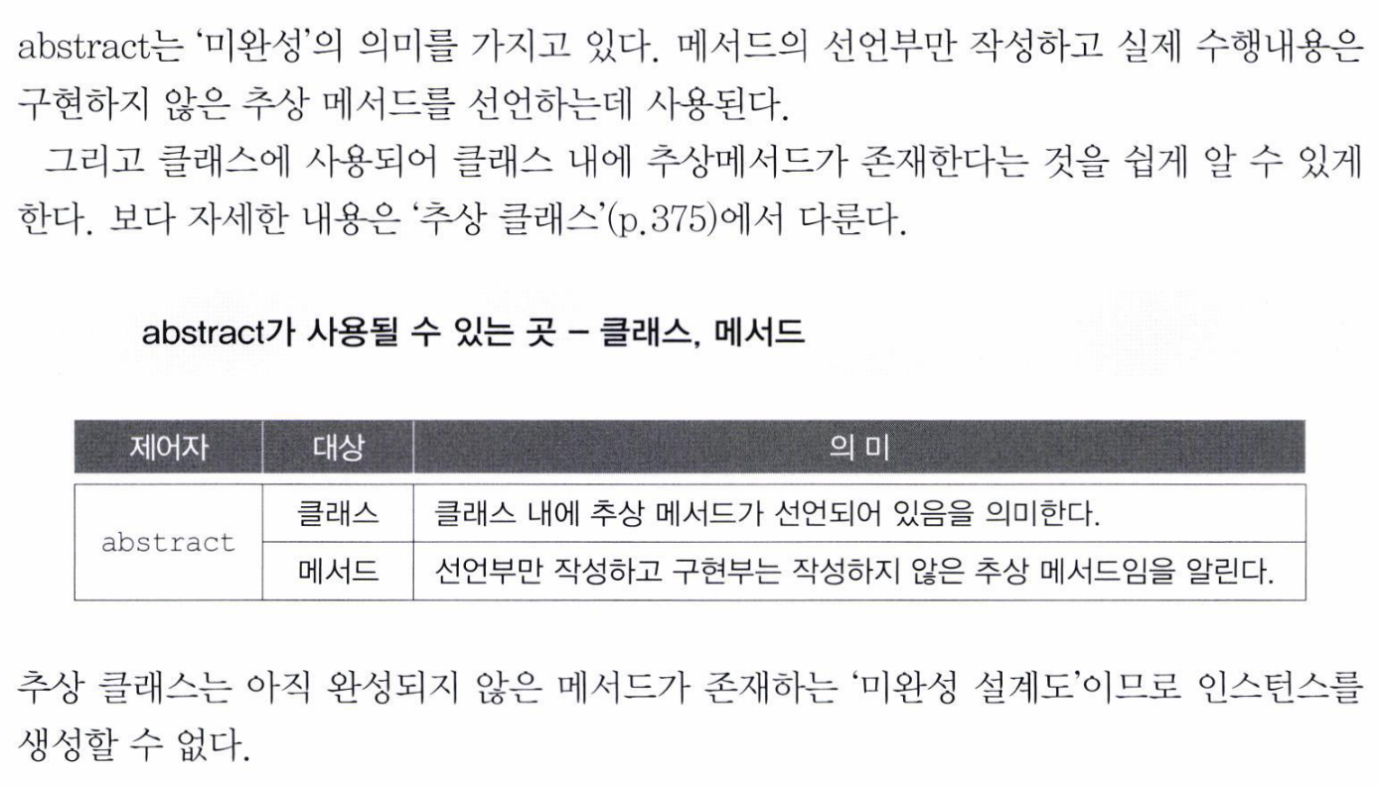

Slide 42
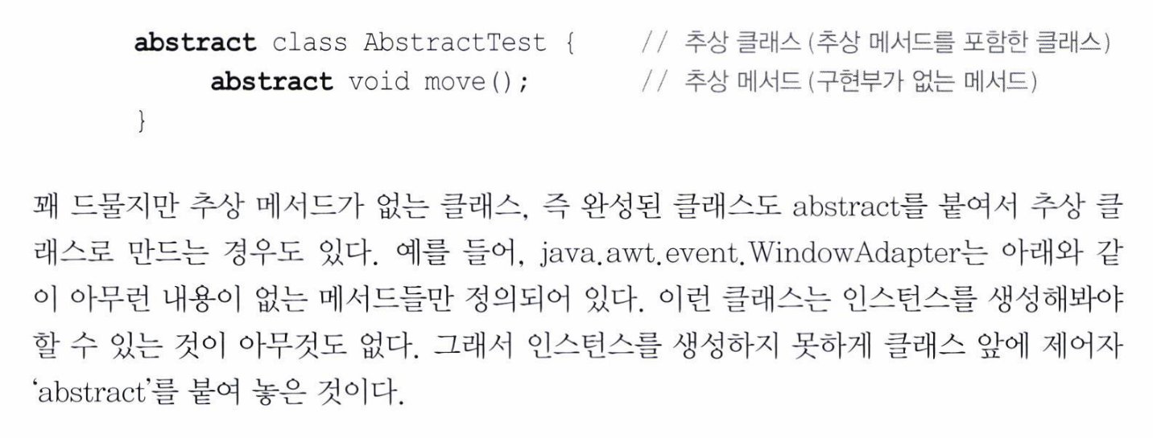

Slide 43
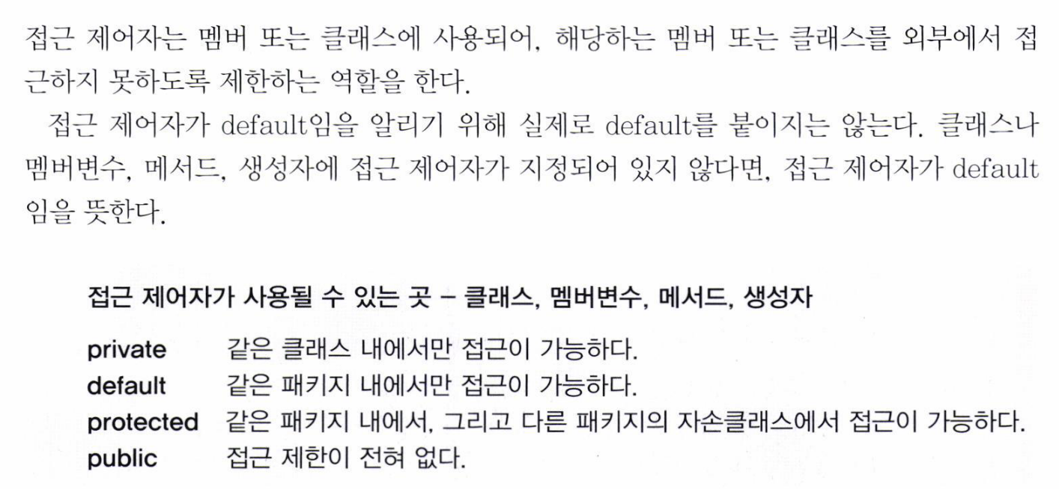

Slide 44
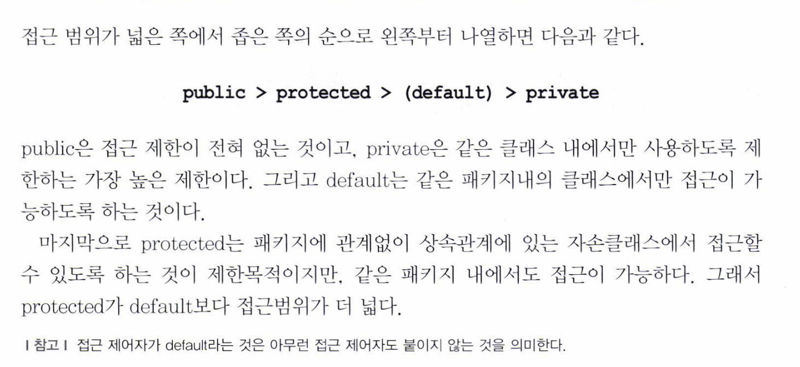

Slide 45
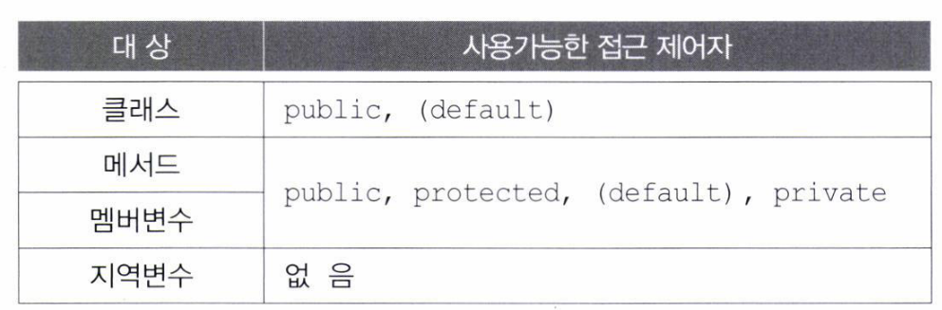

Slide 46
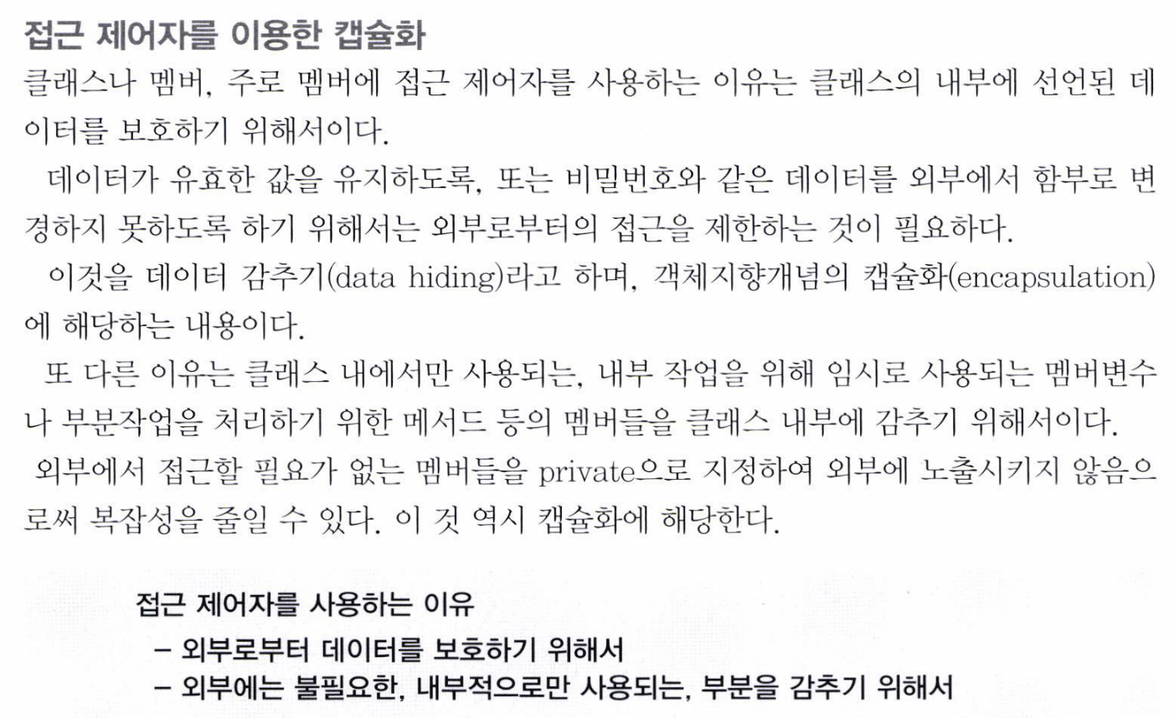

Slide 47
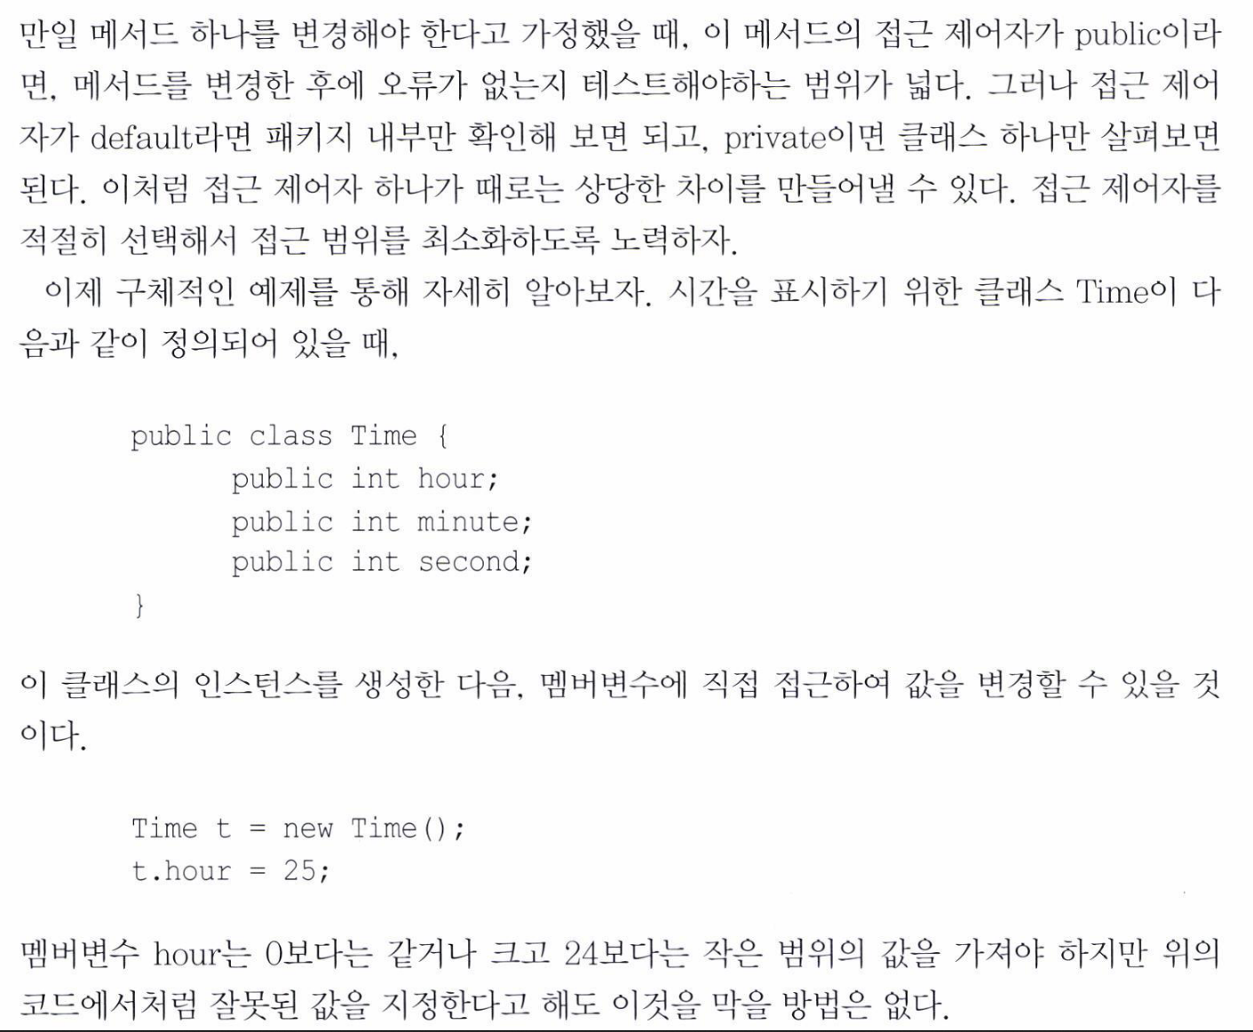

Slide 48
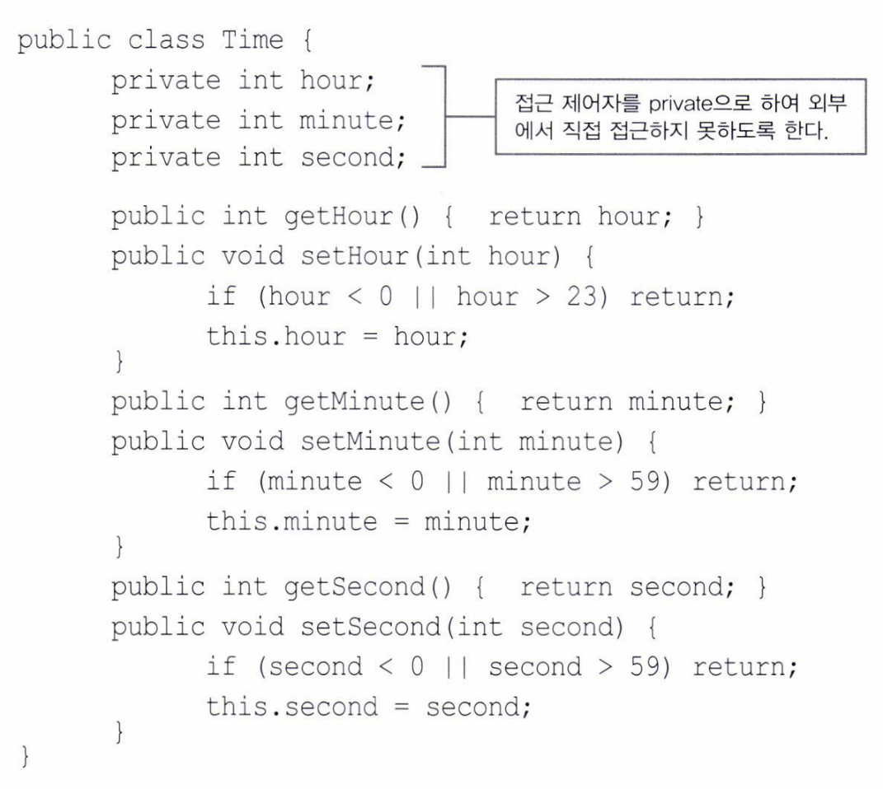

Slide 49
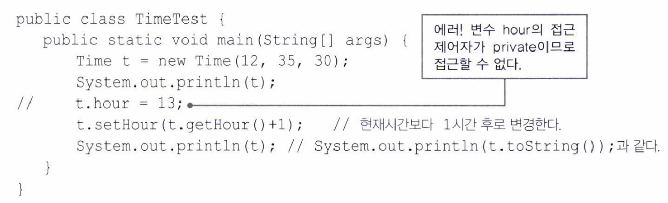
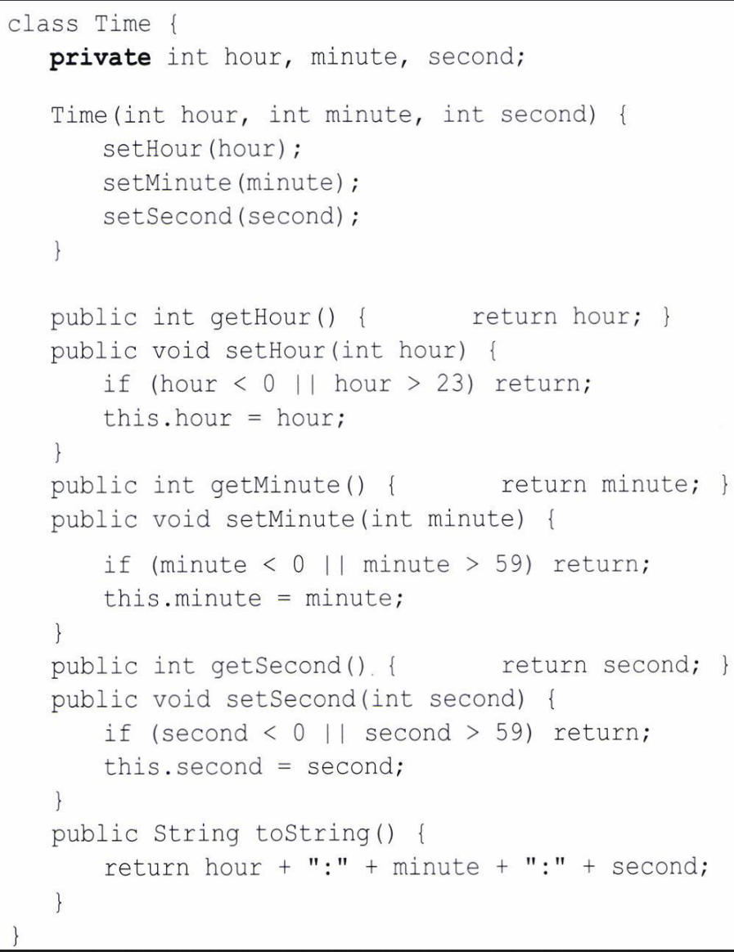
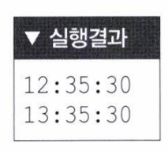

Slide 50


Slide 51


Slide 52


Slide 53


Slide 54


Slide 55
11 Modifier & Polymorphism 11.2 Polymorphism

Slide 56


Slide 57


Slide 58



Slide 59


Slide 60


Slide 61



Slide 62


Slide 63




Slide 64



Slide 65


Slide 66




Slide 67


Slide 68


Slide 69


Slide 70


Slide 71



Slide 73



Slide 74


Slide 75



Slide 76


Slide 77



Slide 78


Slide 79



Slide 80


Slide 83
HTML

Slide 84


Slide 85


Slide 86


Slide 87


Slide 88


Slide 89




Slide 90



Slide 91


Slide 92


Slide 93


Slide 94


Slide 95


Slide 96



Slide 97


Slide 98


Slide 99


Slide 100


Slide 101


Slide 102


Slide 103



Slide 104


Slide 105


Slide 106



Slide 107



Slide 108




Slide 109




Slide 110





Slide 111



Slide 112


Slide 113


Slide 114


Slide 115
HTML
not yet…

